Slide 1
Government of Luxembourg: obstructing European tax reforms

Slide 2
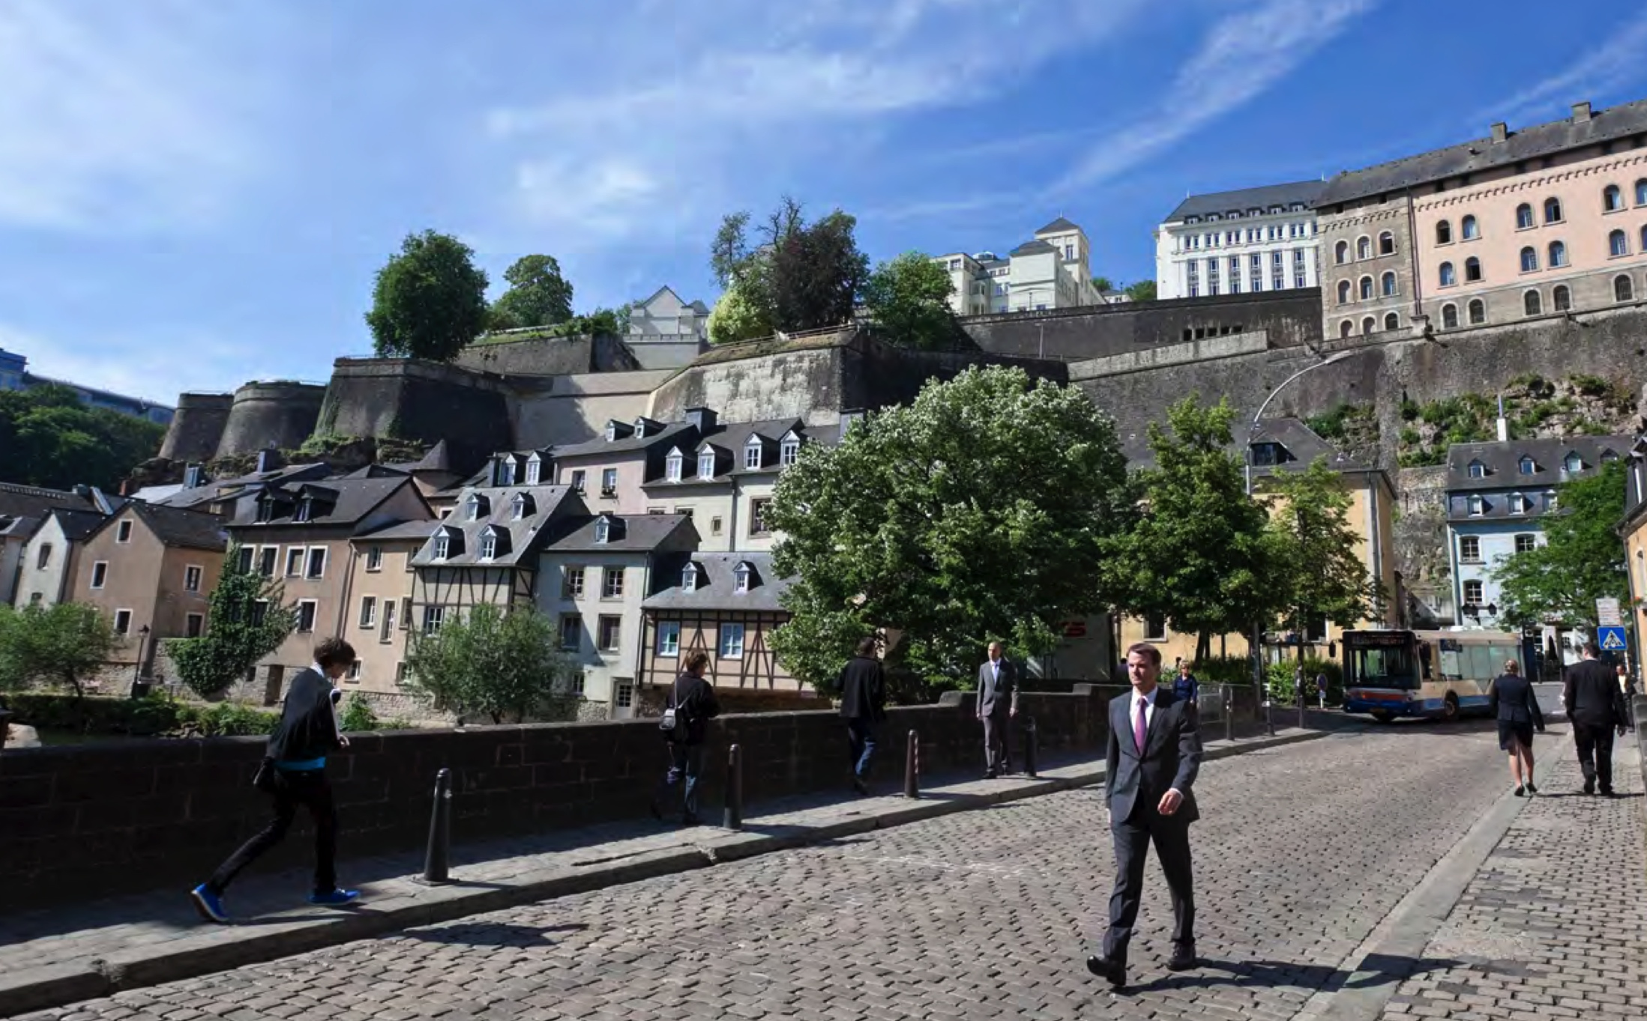
Art. 4.3 of the Treaty on European Union
3. Pursuant to the principle of sincere cooperation, the Union and the Member States shall, in full mutual respect, assist each other in carrying out tasks which flow from the Treaties. ...
The Member States shall facilitate the achievement of the Union's tasks and refrain from any measure which could jeopardise the attainment of the Union's objectives.

Slide 3
The obstruction of reform
The Code of Conduct group
The planned reform
The obstruction of the reform

Slide 4
The Code group
established by the Council through a resolution on the 1st of December 1997
Website: http://www.consilium.europa.eu/en/council-eu/preparatory-bodies/code-conduct-group/

Slide 5
The demands of the European Parliament
on the Code of Conduct Group
calls for an urgent reform of the Group
strengthened transparency and accountability
governance and mandate to be reshaped
permanent and politically accountable chair
improvement of working methods including a possible enforcement mechanism
regular participation of finance ministers or senior officials
harmfulness criteria to be updated and broadened to cover new forms of harmful tax practises, including third countries
Chair of the Group and Council to report regularly to ECON committee of the European Parliament
consider to set up a “high level group on taxation policy” (“tax committee”) similar to the Economic and Financial Committee (EFC)
give the European Parliament the right of initiative to denounce to the Code of Conduct Group national measures it deems harmful
produce a second update of the Simmons & Simmons report on administrative tax practices (1999)
Enhance strategic synergies between the reformed Code Group and the Commission’s enforcement of competition rules
support for the proposals of the European Commission in its action plan of the 17th of June 2015 for fair and efficient corporate taxation

Slide 6
The demands of the European Parliament
on the Code of Conduct Group
support for the proposals of the European Commission in its action plan of the 17th of June 2015 for fair and efficient corporate taxation

Slide 7
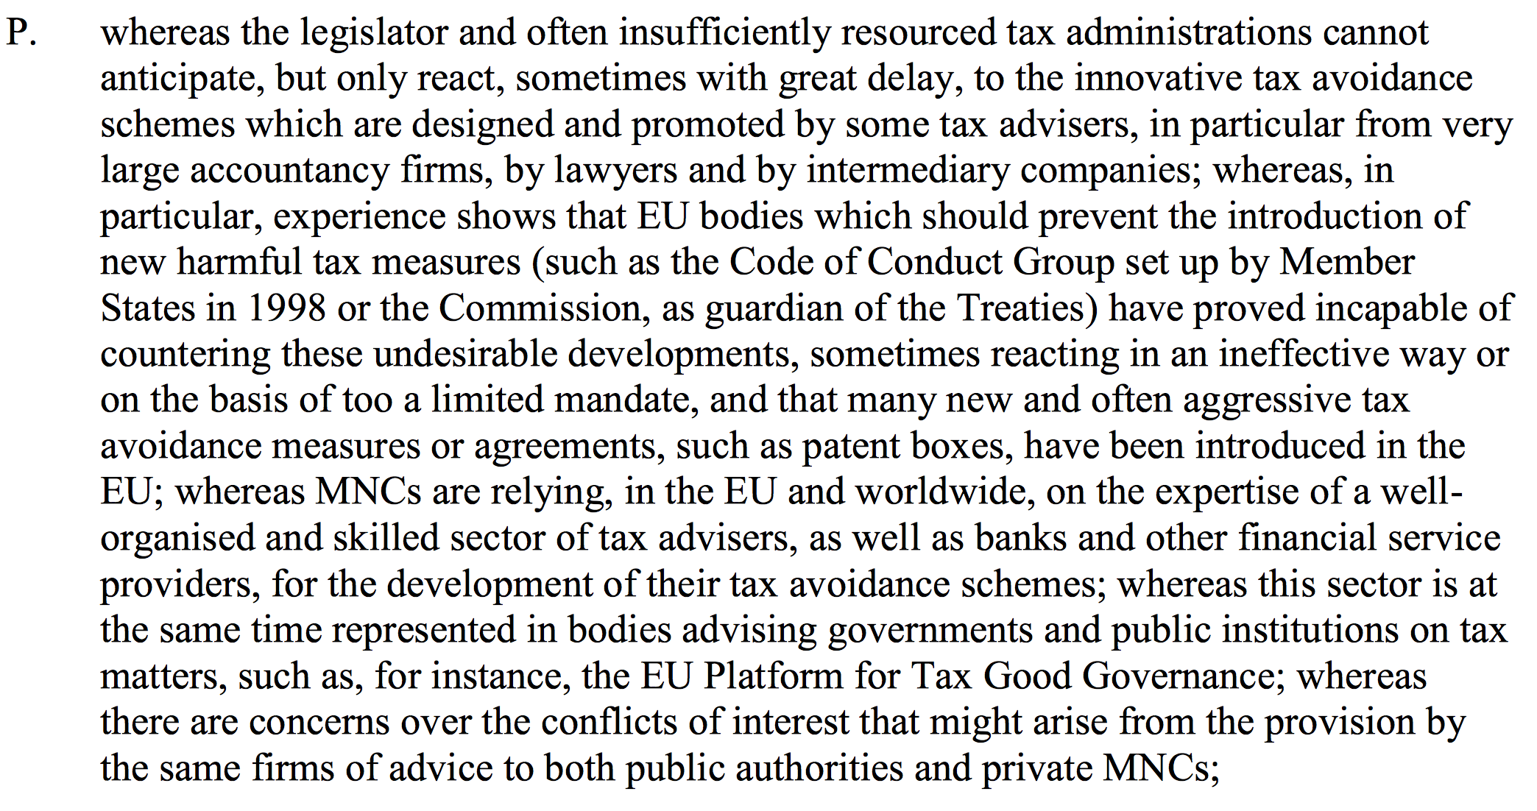
Findings & demands of the European Parliament
Final report of the TAXE committee of the European Parliament, adopted 25th of November 2015

Slide 8
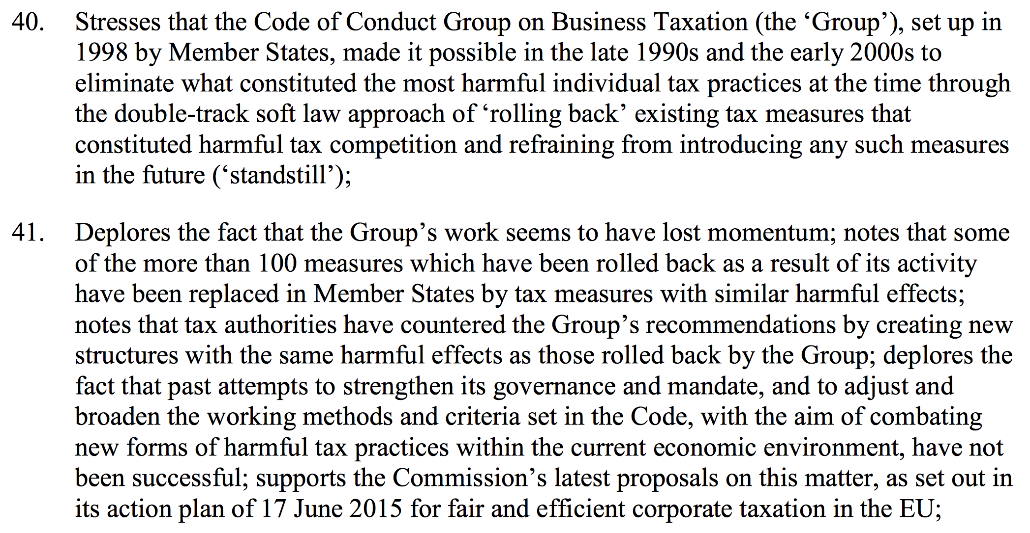
Final report of the TAXE committee of the European Parliament, adopted 25th of November 2015

Slide 9
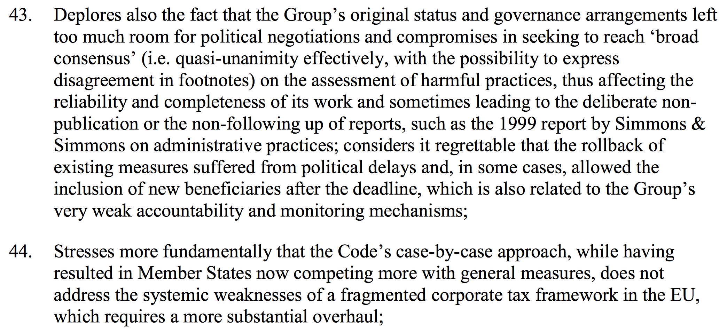
Final report of the TAXE committee of the European Parliament, adopted 25th of November 2015

Slide 10
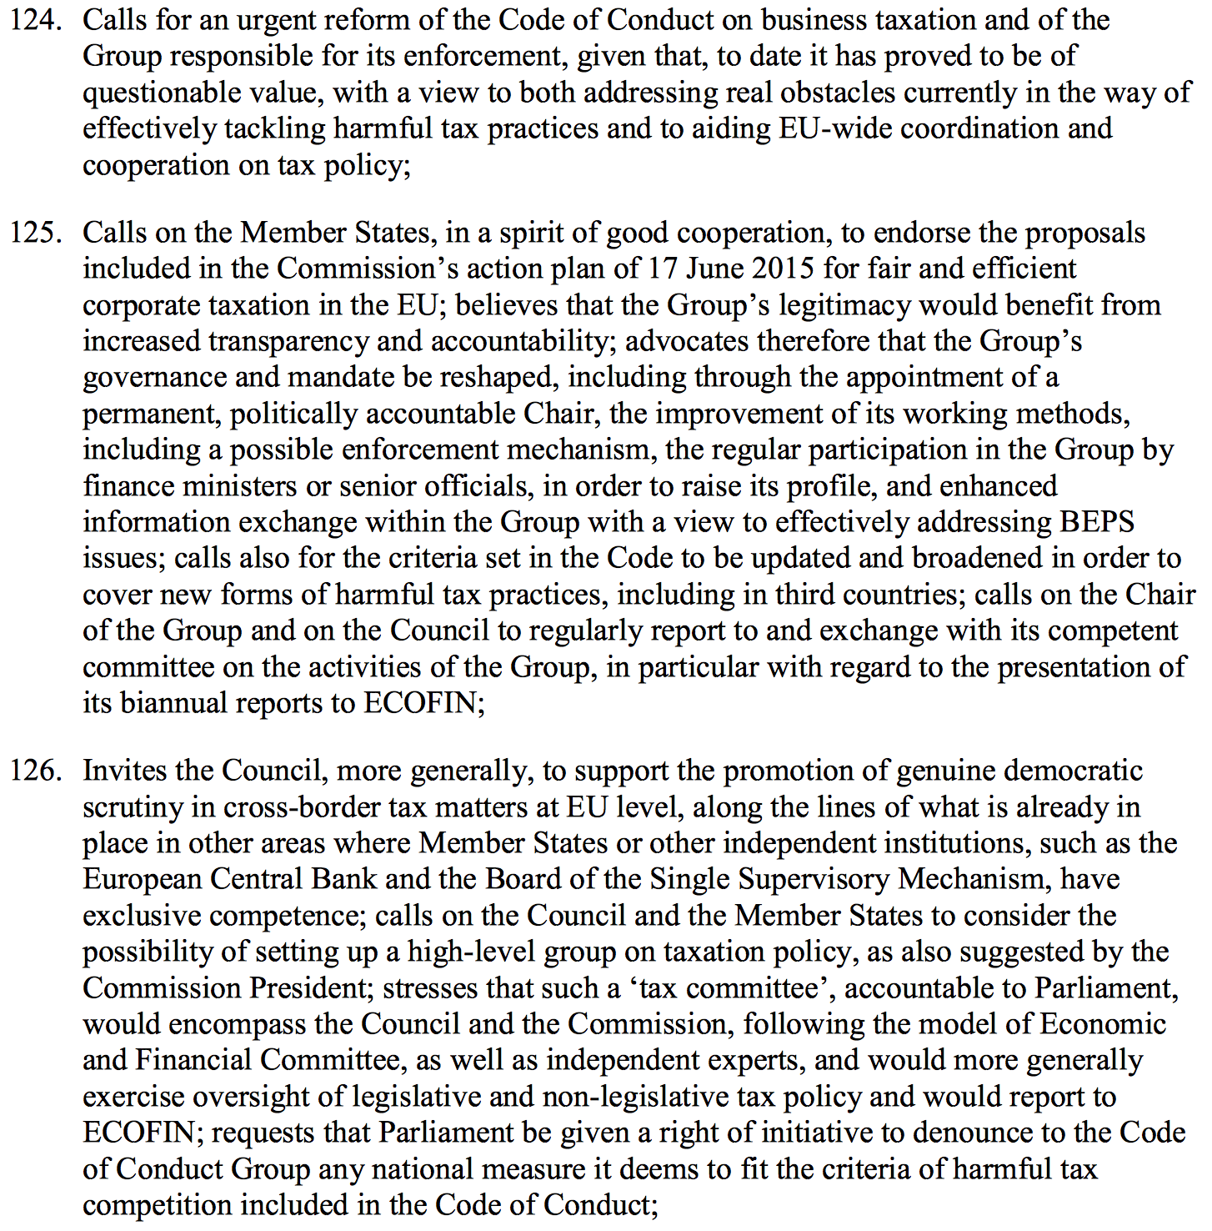
Final report of the TAXE committee of the European Parliament, adopted 25th of November 2015

Slide 11
Final report of the TAXE committee of the European Parliament, adopted 25th of November 2015

Slide 12
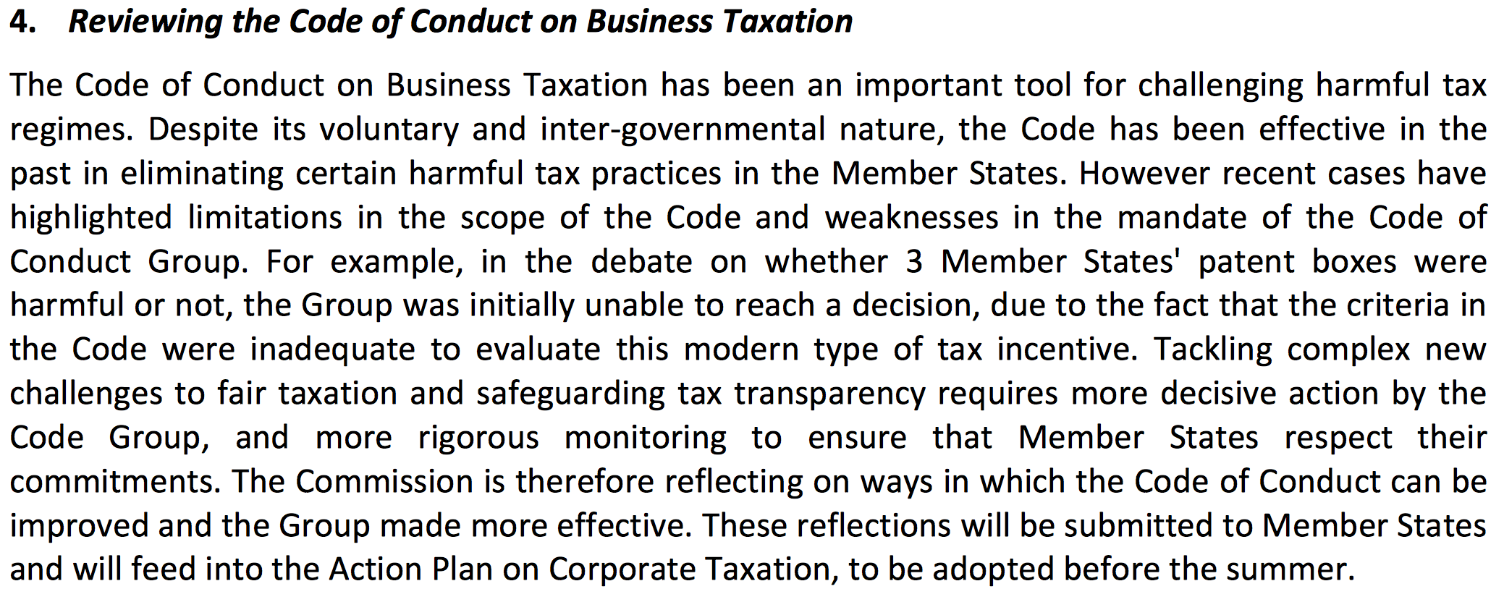
EU Commission on the 17th of March 2015:
“Communication from the Commission to the European Parliament and the Council on tax transparency to fight tax evasion and avoidance”

Slide 13
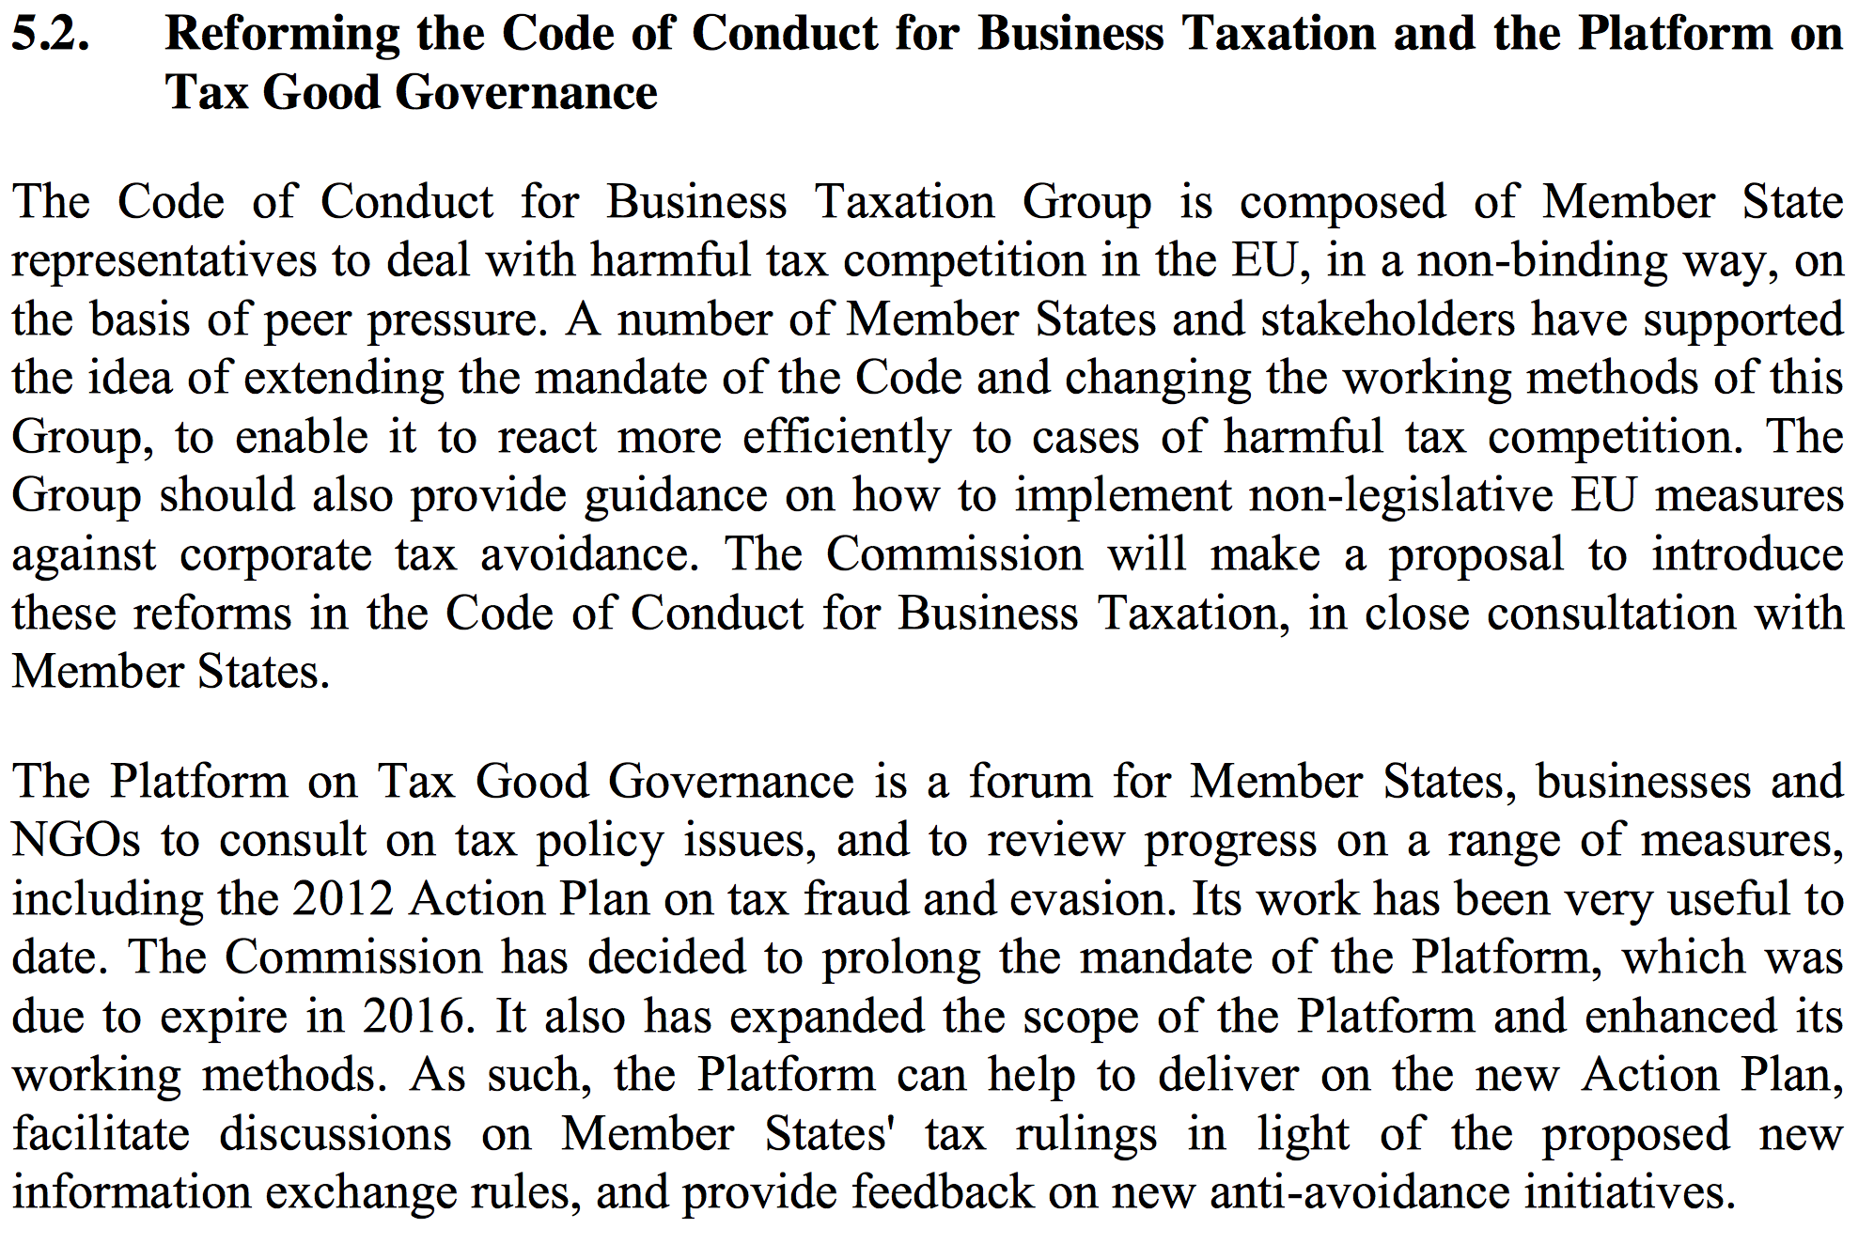
EU Commission on the 17th of June 2015:
“Communication from the Commission to the European Parliament and the Council: A fair and efficient corporate tax system in the European Union”

Slide 14
EU Commission on the 17th of June 2015: “Communication from the Commission to the European Parliament and the Council: A fair and efficient corporate tax system in the European Union” Questions & Answers
http://europa.eu/rapid/press-release_MEMO-15-5175_en.htm

Slide 15
The Council’s deliberations on the
reform of the Code of Conduct Group
Five Proposals on 11th of June 2015:
http://data.consilium.europa.eu/doc/document/ST-9620-2015-INIT/en/pdf
EcoFin, 8th December 2015 votes conclusions to reform the group and decided to finalize work on reform in the first half of 2016
http://www.consilium.europa.eu/en/press/press-releases/2015/12/08-ecofin-conclusions-business-taxation/
EcoFin, 8th March 2016
Reformed criteria to be voted

Slide 16
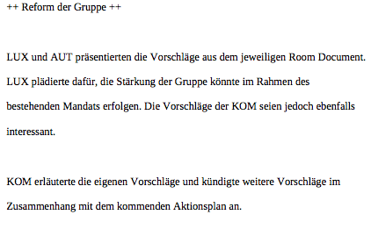
Code of Conduct Group, 4th April 2015 Mitschrift des dt. Finanzministeriums

Slide 17
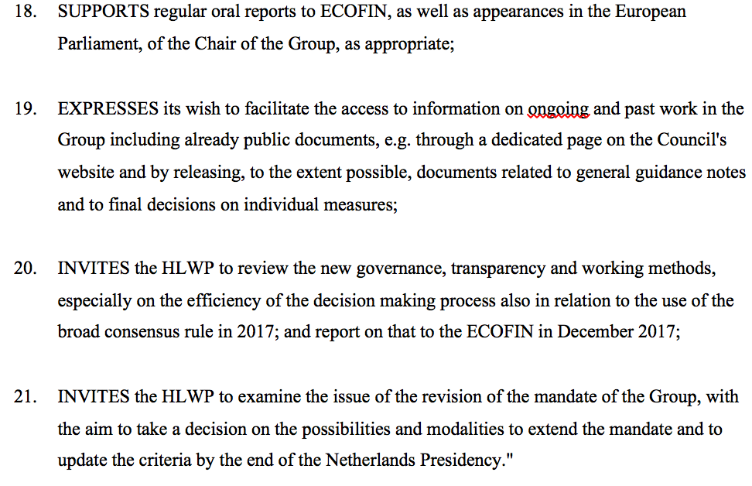
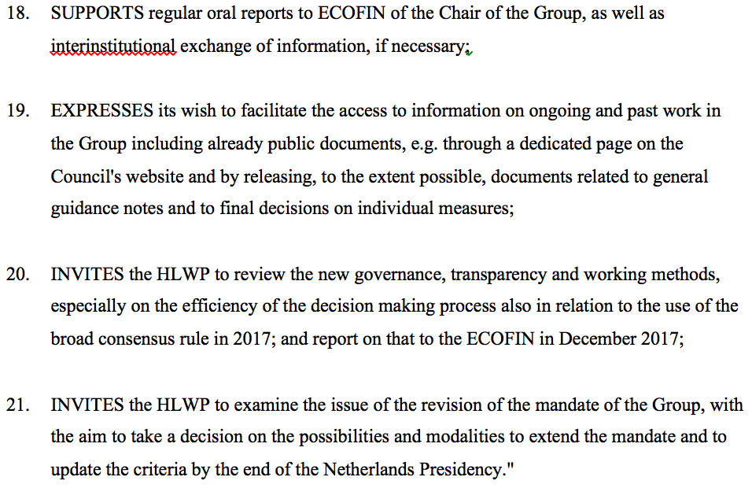
Draft EcoFin Conclusions „Future of the Code of Conduct (business taxation)“: Rights of the European Parliament deleted
draft of 26th February 2016
draft of 4th March 2016

Slide 18
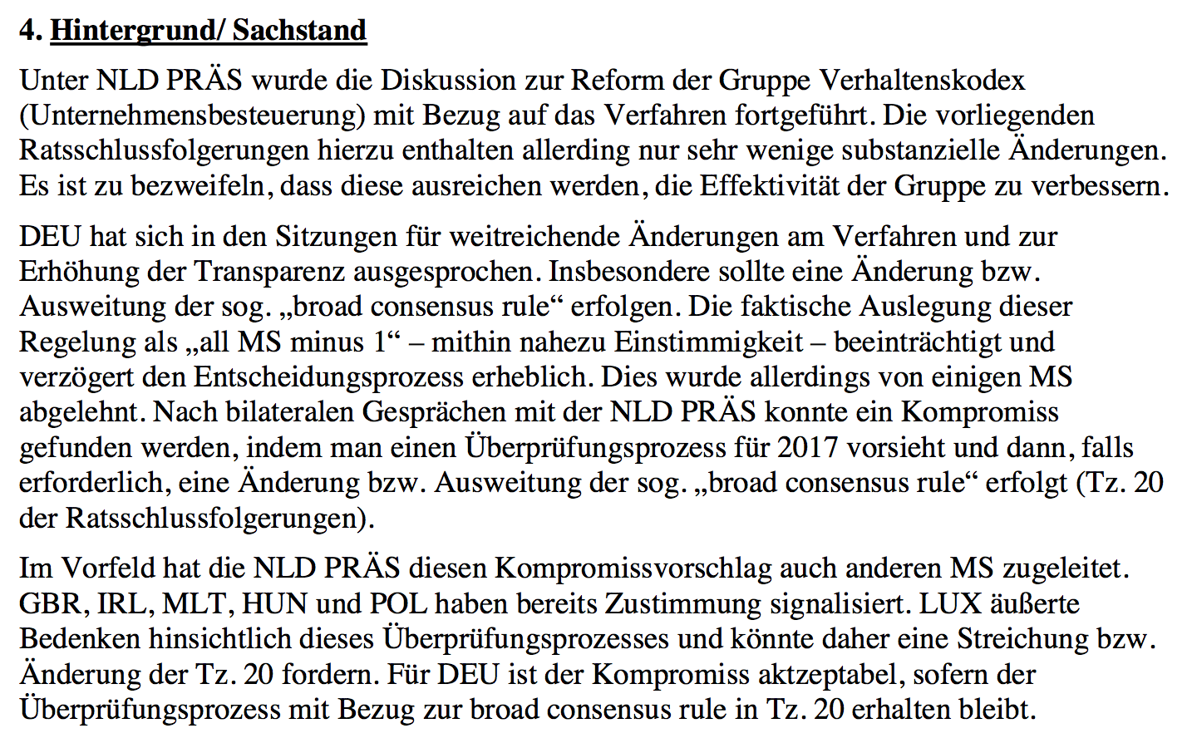
Weisung des dt. Finanzministeriums zum AStV vom 2.3.2016

Slide 19
Government of the Netherlands: obstructing the TAXE investigation

Slide 20
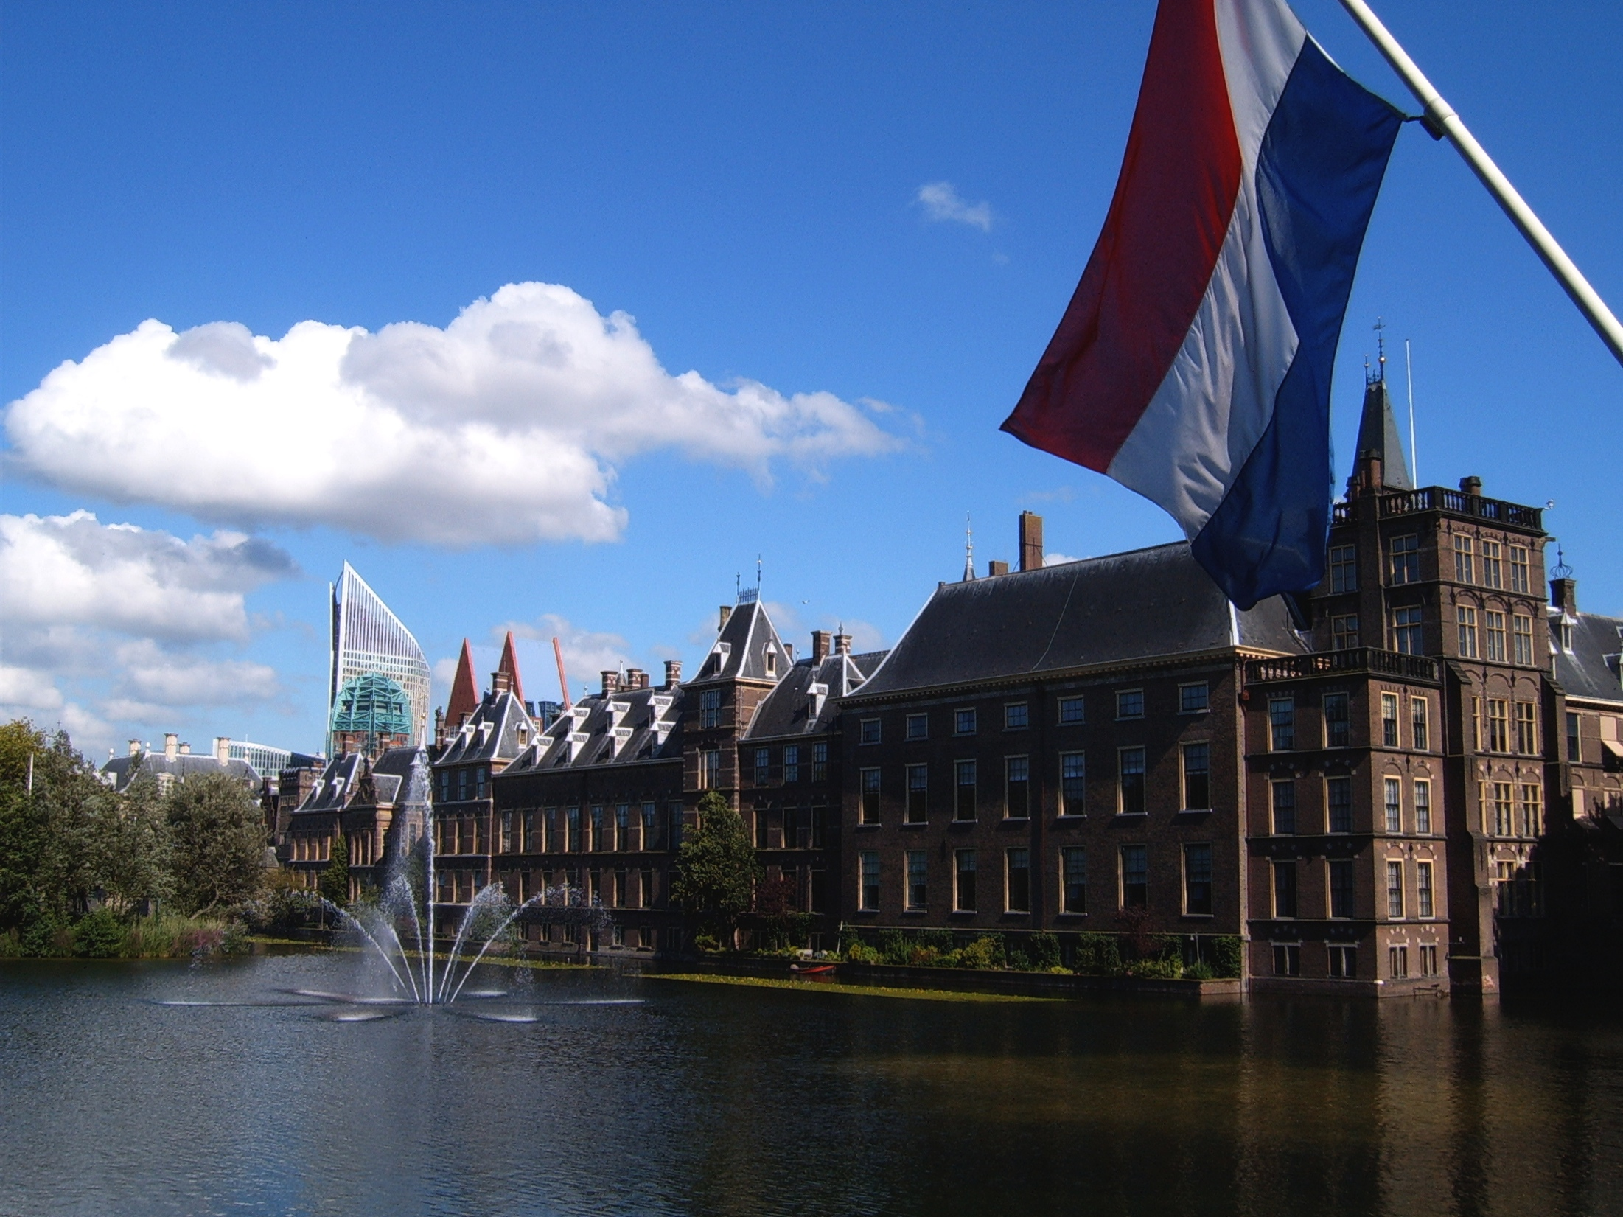
Art. 4.3 of the Treaty on European Union
3. Pursuant to the principle of sincere cooperation, the Union and the Member States shall, in full mutual respect, assist each other in carrying out tasks which flow from the Treaties. ...
The Member States shall facilitate the achievement of the Union's tasks and refrain from any measure which could jeopardise the attainment of the Union's objectives.

Slide 21
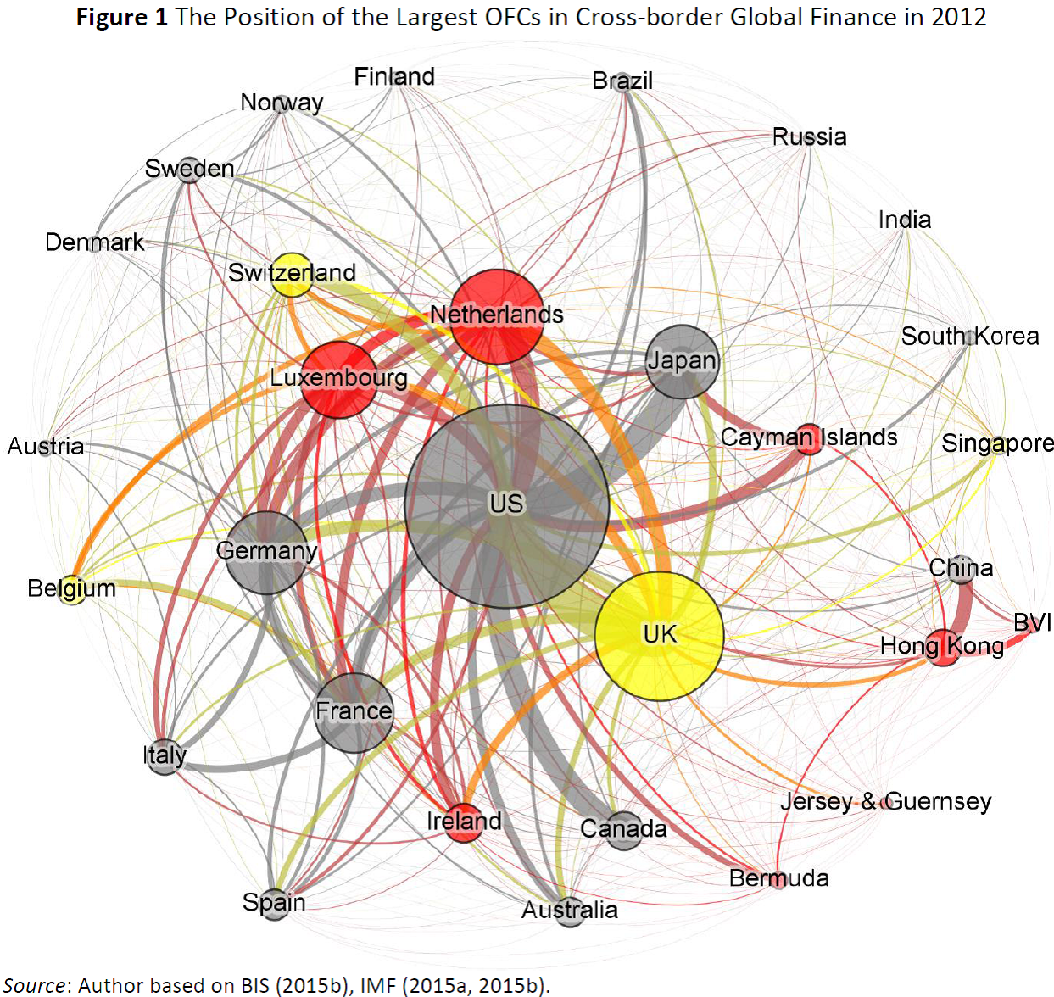
https://www.academia.edu/15386988/The_Offshore-Intensity_Ratio_Identifying_the_Strongest_Magnets_for_Foreign_Capital

Slide 22
The obstruction of investigation
1. denial of access to documents of the Code of Conduct group
2. breach of promise to the Dutch parliament to co-operate fully with the investigation of the European Parliament
3. denial rather than strong reform of aggressive tax avoidance policies of the Netherlands
4. denial to accept Commission’s modest verdict on illegal state aid to Starbucks

Slide 23
European Parliament is denied access to key information
The Code of Conduct group on business taxation has been evaluating several hundred of potentially harmful tax regimes since 1998. Who denies what:
Council: denies minutes and room documents of the meetings
Commission: denies informal minutes of its services
Commission has granted access to room documents since 2010 and announced to give access to older room documents since 1998 but makes access contingent to ex-ante approval by member states.
Member states: 15 have granted access, 13 have asked COM to blacken all their information.

Slide 24
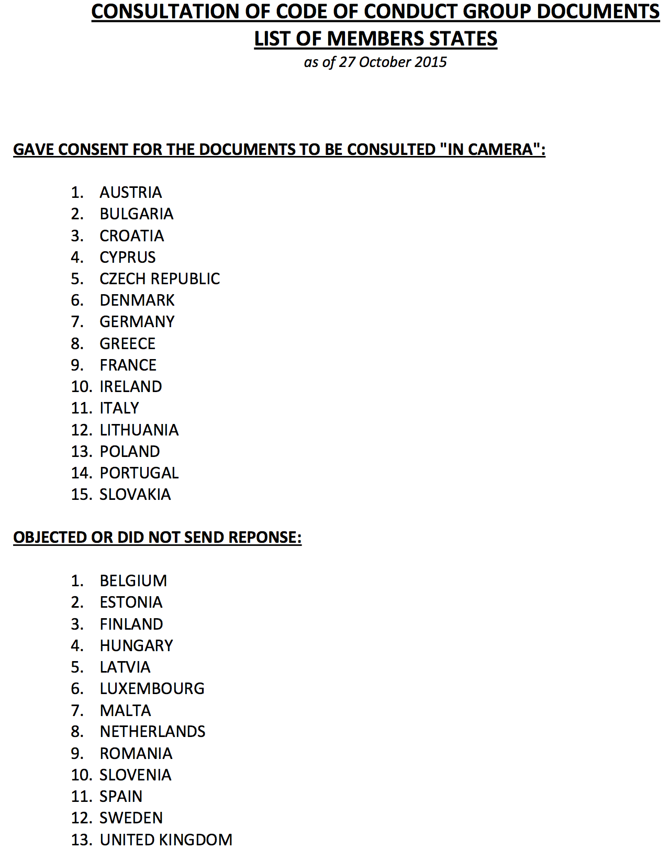

Slide 25
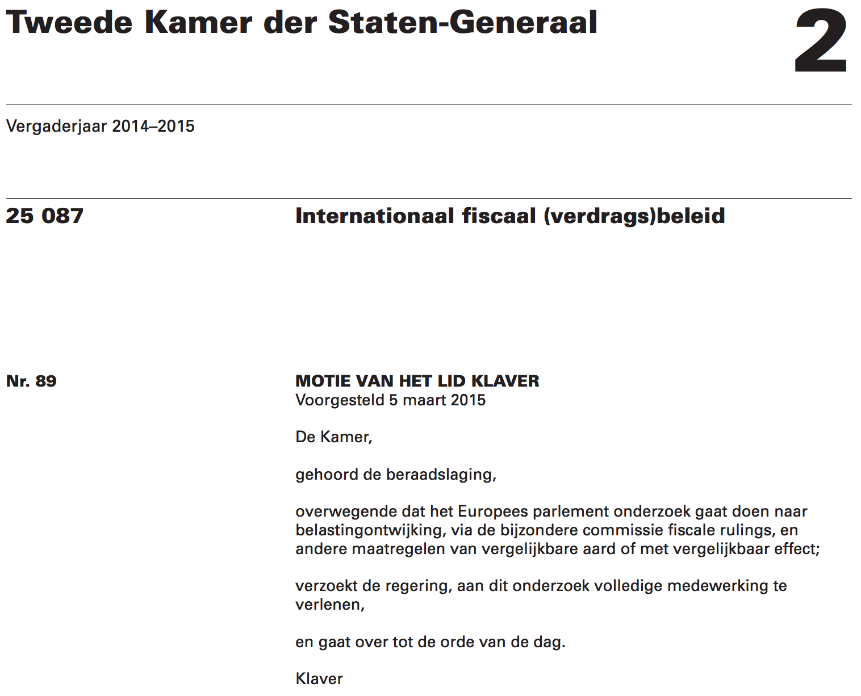

Slide 26
Why the denial is harming the investigation
patent boxes (or innovation boxes as call in NL) looked at by the Code of Conduct group in Sept 2014 with at least one harmful criteria met. But Dutch documents in the room documents are black.
interest and royalties deduction. This was also on the agenda of the code of conduct (work programme 2011) but again the room documents are all in black concerning the NL.

Slide 27
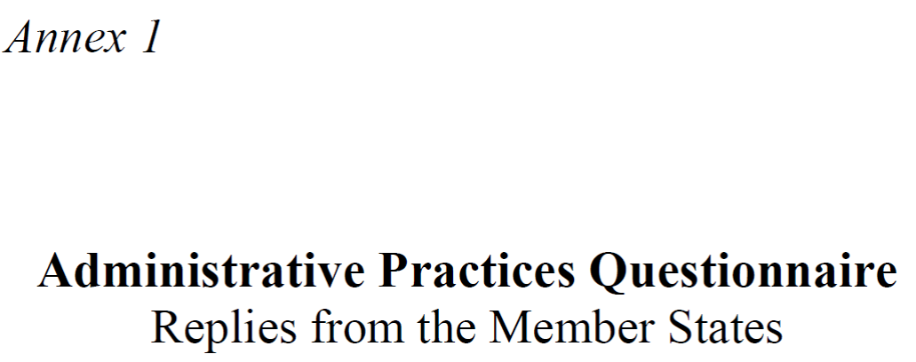
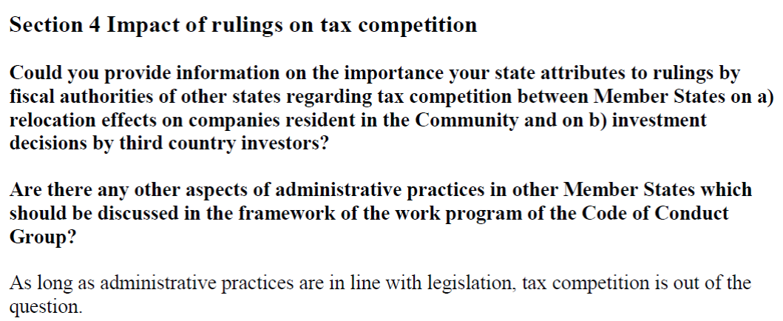
The Dutch government‘s ironic repsonse to the Code of Conduct group‘s questionaire on tax rulings

Slide 28
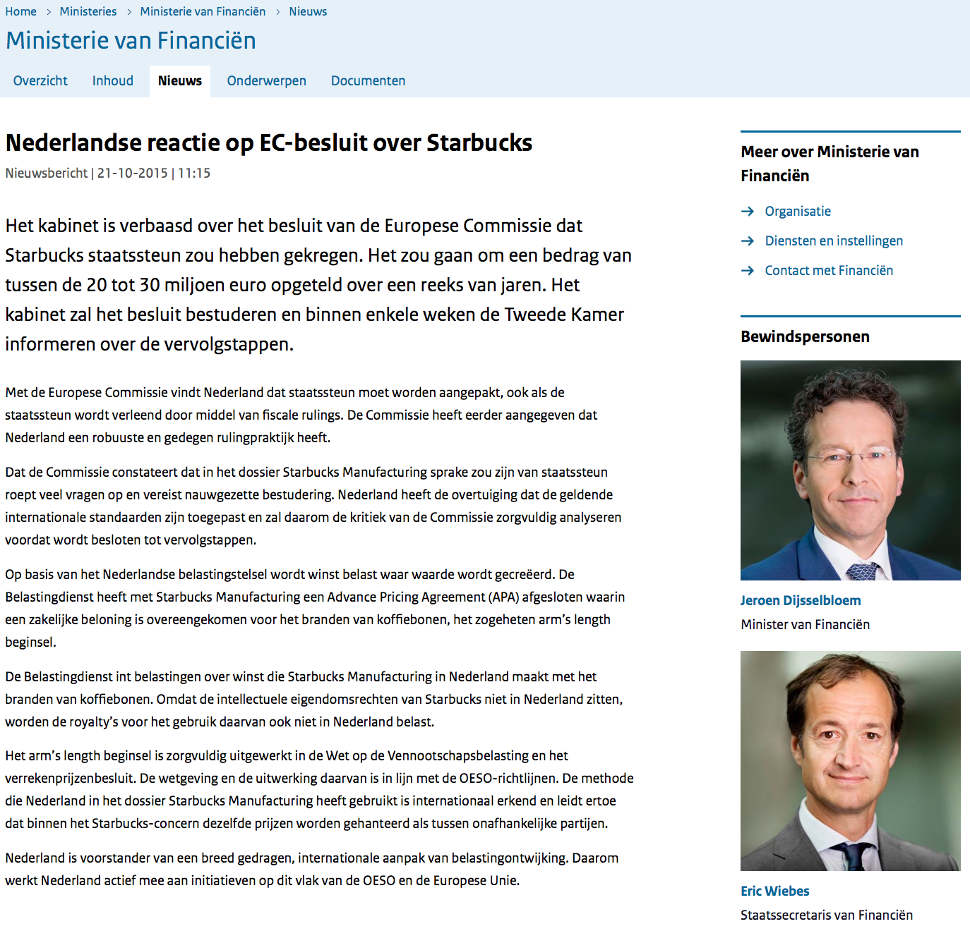
Reaction to the EU commission‘s state aid decision on Starbucks

Slide 30
From now to your information: The presentation I gave on the 26th of October in Luxembourg

Slide 31
Government of Luxembourg: obstructing the TAXE investigation

Slide 32
Art. 4.3 of the Treaty on European Union
3. Pursuant to the principle of sincere cooperation, the Union and the Member States shall, in full mutual respect, assist each other in carrying out tasks which flow from the Treaties. ...
The Member States shall facilitate the achievement of the Union's tasks and refrain from any measure which could jeopardise the attainment of the Union's objectives.

Slide 33
Obstruction of investigation in 7 acts
1. no serious answer to EP’s questions
2. denial of access to documents of the Code of Conduct group
3. Council not granting the EP anything meaningful (confirmed hearing in EP on 22nd of Sept 2015)
4. ring fencing access of EU commission to exchange of rulings legislated under Luxembourg presidency
5. no consequences from the WALMART scandal
6. failure to deliver the promised “vade-mecum” on economic substance
7. making an example of tax whistleblower Antoine Deltour

Slide 35
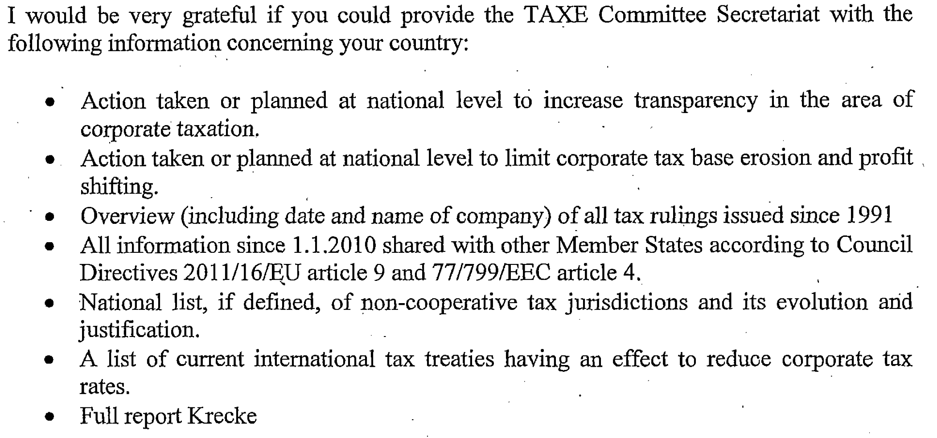
Demand for information of TAXE to Luxembourg of 23rd April 2015

Slide 36
Information received June 2015
Quelle: http://www.sven-giegold.de/wp-content/uploads/2015/03/Luxembourg.pdf

Slide 37
Information received June 2015
Quelle: http://www.sven-giegold.de/wp-content/uploads/2015/03/Luxembourg.pdf

Slide 39
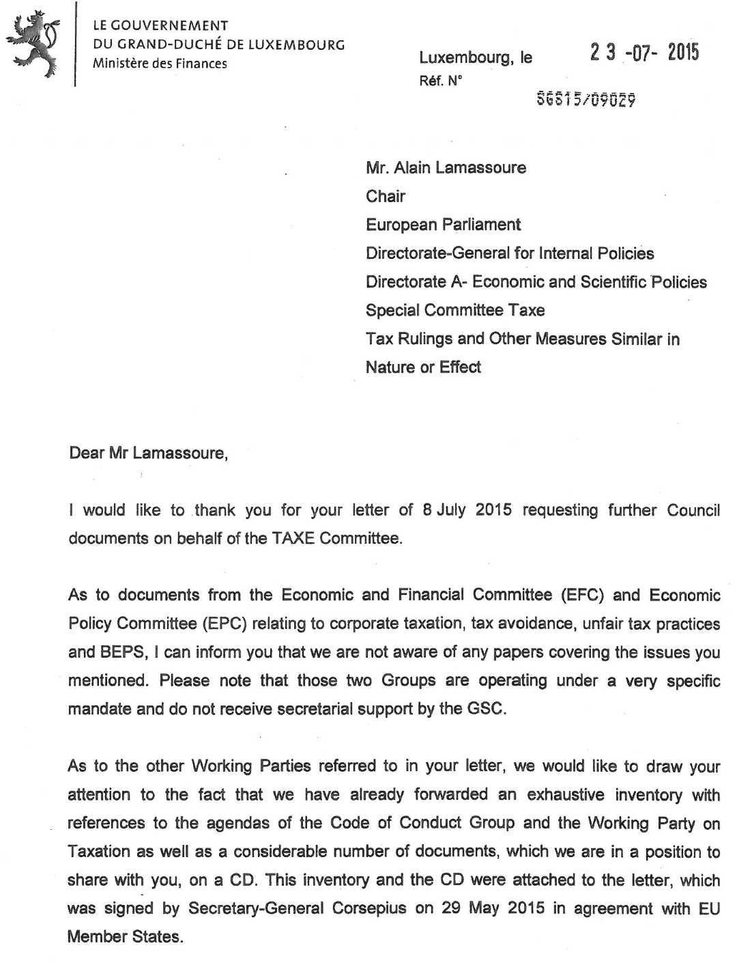
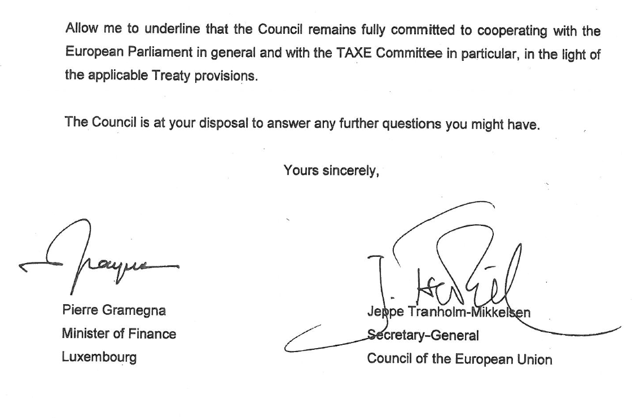
Response Council 23rd July 2015 to request from 22nd April 2015

Slide 40
Charter of fundamental rights of the European Union

Slide 41
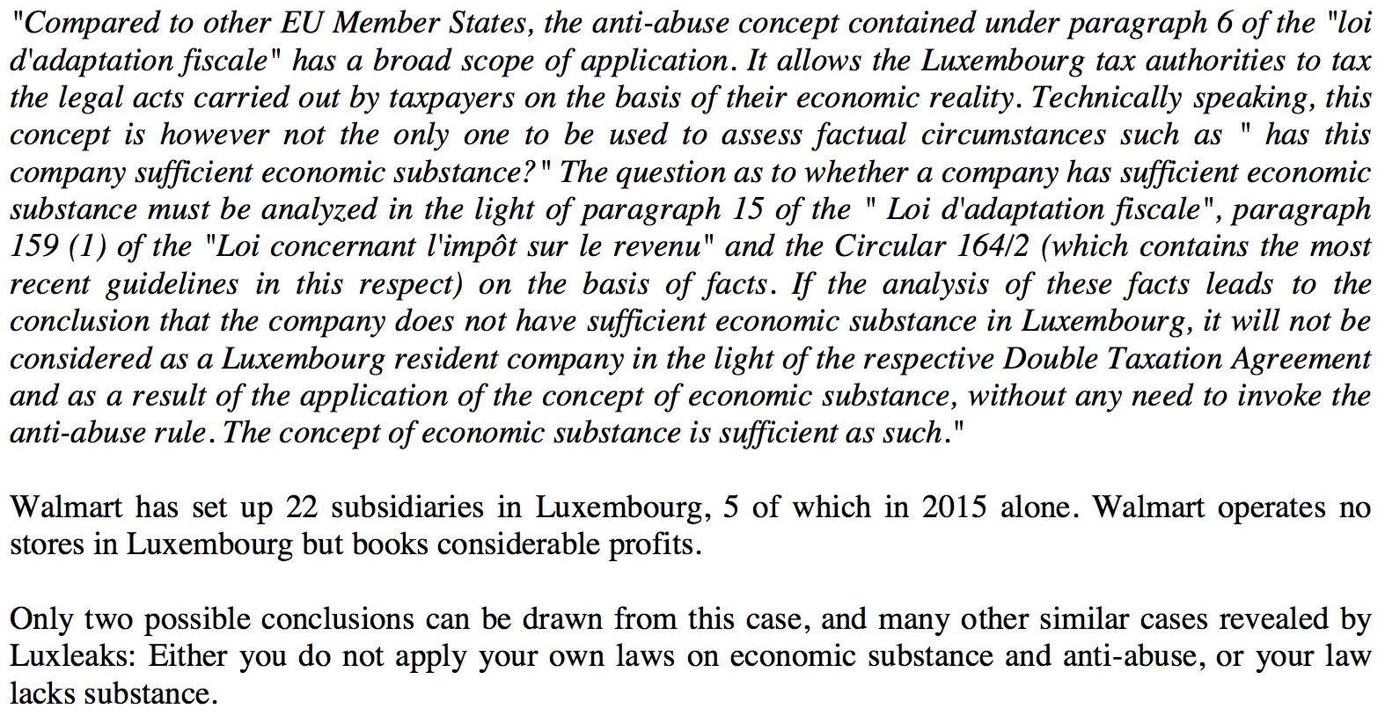
Greens/EFA letter to minister Gramegna on WALMART of 14th July 2015

Slide 42
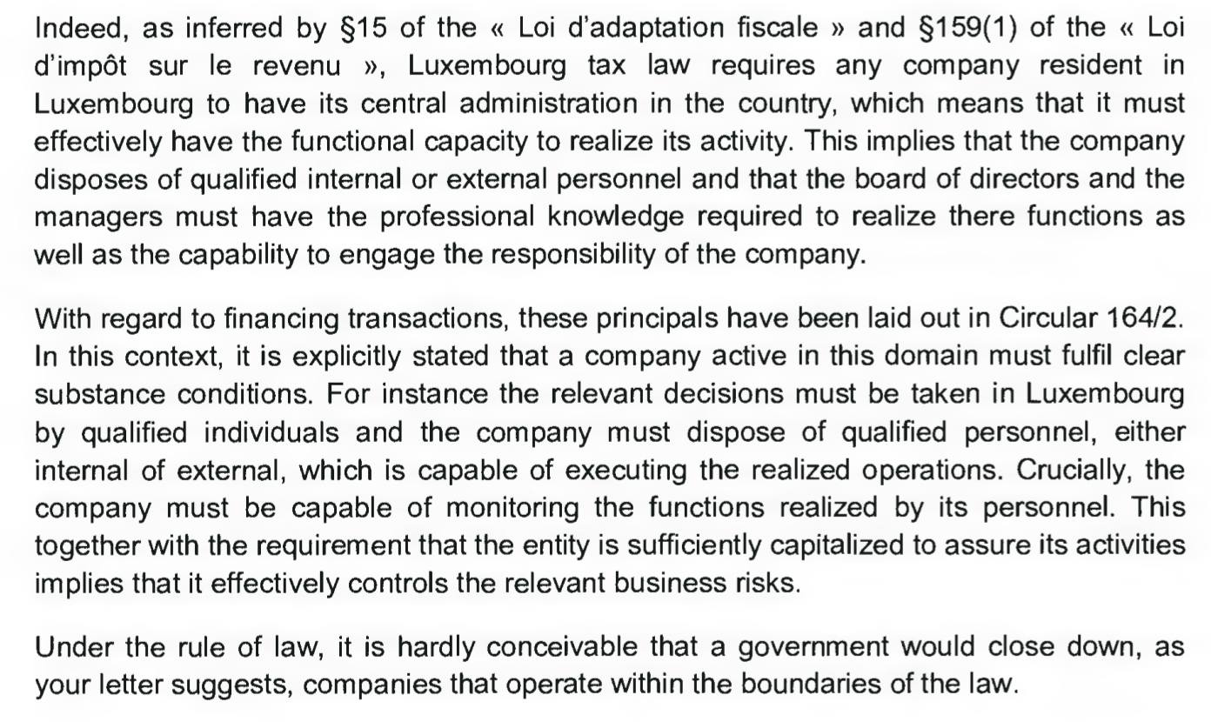
Response by Pierre Gramegna on WALMART, 28th of August 2015

Slide 43
European Parliament‘s mission report on the TAXE visit, 18th May 2015
http://www.sven-giegold.de/wp-content/uploads/2015/03/Mission-report-Lux.pdf

Slide 44
Key quotes
„The government of Luxembourg has systematically obstructed the tax investigation of the European Parliament.“
„Transparency is fundamental to democracy. Citizens and the European Parliament have a right to get access to all relevant documents of the Council. The Luxembourg presidency harms citizens‘ respect in the European Parliament by refusing access to minutes and documents.“
„I call on the government of Luxembourg to give access to all documents and minutes of the Code of Conduct group on business taxation.“
„Luxembourg has still to prove that it has changed. The denial of transparency to the directly elected European Parliament does not fit to the new clean image of the financial centre.“

Slide 45
Additional reading
EU Commission (2014): State aid investigations against Fiat Finance/Luxembourg. http://ec.europa.eu/competition/state_aid/cases/253203/253203_1590108_107_2.pdf
EU Commission (2015): Commission decides selective tax advantages for Fiat in Luxembourg and Starbucks in the Netherlands are illegal under EU state aid rules. http://europa.eu/rapid/press-release_IP-15-5880_en.htm
Financial Times (2015): The case against Luxembourg: http://ftalphaville.ft.com/2015/10/21/2142483/the-case-against-luxembourg/
Jan Fichtner (2015): The offshore intensity ratio. https://www.academia.edu/15386988/The_Offshore-Intensity_Ratio_Identifying_the_Strongest_Magnets_for_Foreign_Capital

Slide 46
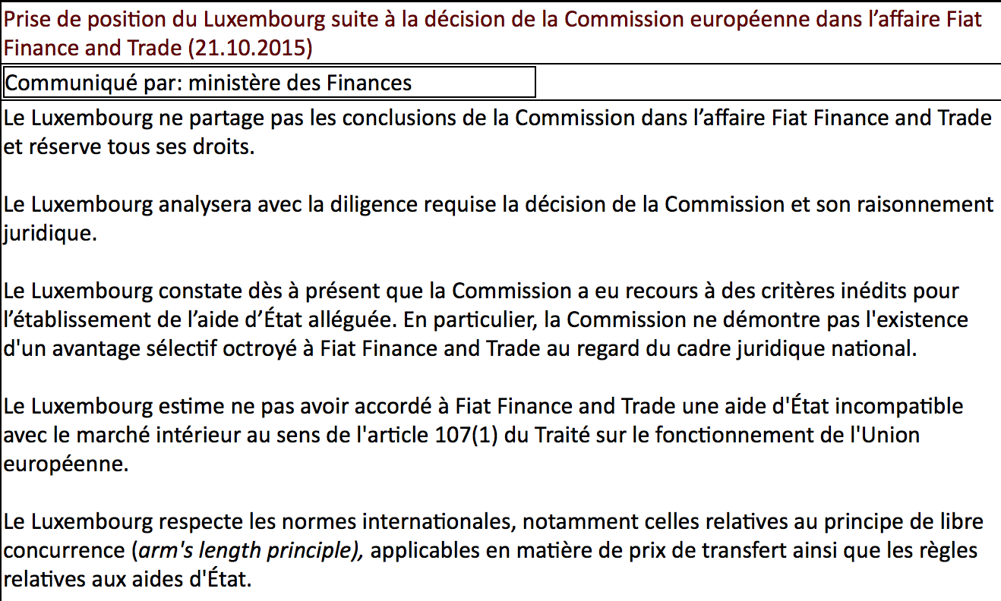

Slide 47
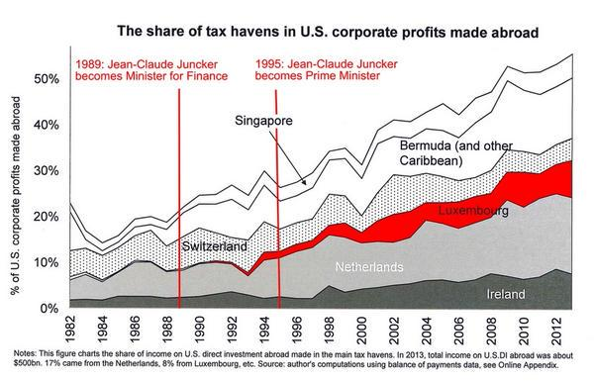
http://www.taxjustice.net/wp-content/uploads/2015/04/Juncker-Luxembourg.jpg

Slide 48
https://www.academia.edu/15386988/The_Offshore-Intensity_Ratio_Identifying_the_Strongest_Magnets_for_Foreign_Capital

Slide 49
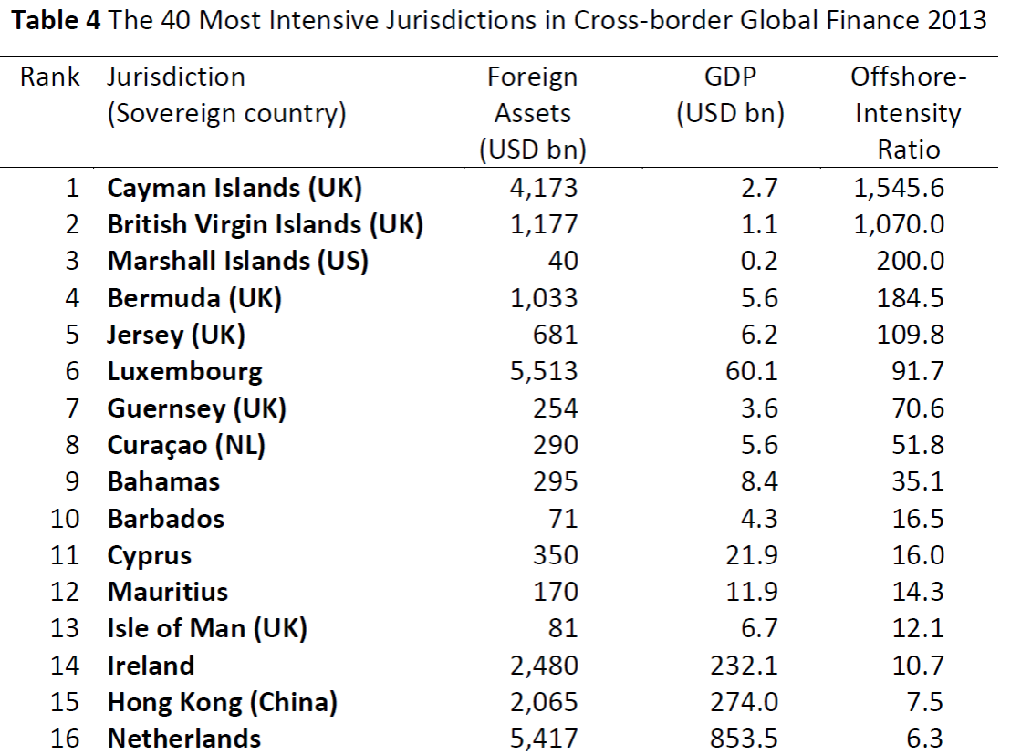
https://www.academia.edu/15386988/The_Offshore-Intensity_Ratio_Identifying_the_Strongest_Magnets_for_Foreign_Capital

